Slide 1
Parsing with CFG

Slide 2
Outline
Parsing as search
Ambiguity
Dynamic Programming parsing methods

Slide 3
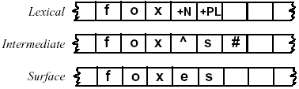
Parsing Vs. Generation - Background
Parsing vs. Generation: which is more complex?
Parsing can be slightly more complicated than generation, because of the problem of ambiguity.
For example, foxes could be fox +V +3SG as well as fox +N +PL
Ex: foxes can also be a verb (meaning “to baffle or confuse”)
Hence the lexical parse for foxes could be fox +V +3Sg as well as fox +N +PL.
Parsing the lexical tape from the surface tape
Generating the surface tape from the lexical tape

Slide 4
Parsing with CFG
Context-free grammars:
declarative formalism
Do not specify how the parse tree for a given sentence should be computed
So we need to specify parsing algorithms that employ these grammars to produce trees.
three most widely used parsing algorithms for automatically assigning a complete context-free (phrase structure) tree to an input sentence.

Slide 5
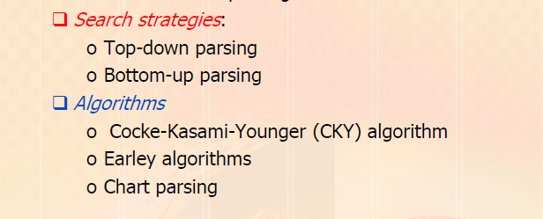
Parsing with CFG

Slide 6
Parsing with CFG
Applications of Parse trees
grammar checking in word-processing systems;
a sentence which cannot be parsed may have grammatical errors (or at least be hard to read).
parse trees serve as an important intermediate stage of representation for semantic analysis
Applications like question answering and information extraction.
Ex: to answer the question
What books were written by Indian women authors before 1800?
need to know that the subject of the sentence was what books to help us figure out that the user wants a list of books (and not a list of authors)

Slide 7
Parsing as Search
In syntactic parsing, the parser can be viewed as searching through the space of possible parse trees to find the correct parse tree for a given sentence.
the search space of possible parse trees is defined by a grammar.
Ex: Book that flight
Draw parse tree for “Book that flight” using the CFG

Slide 8
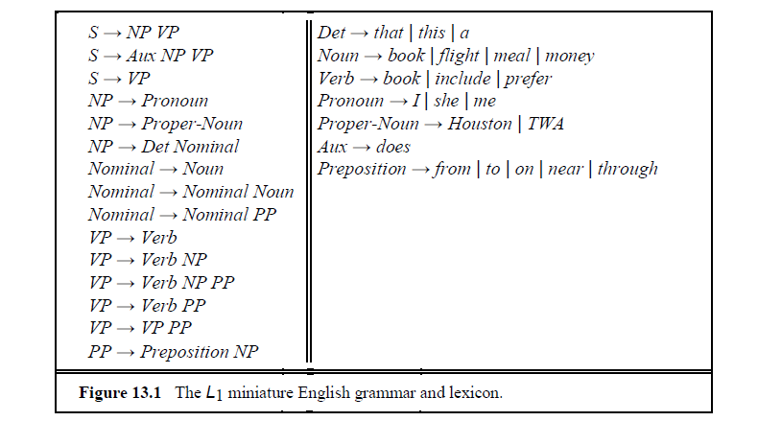
Parsing as Search

Slide 9
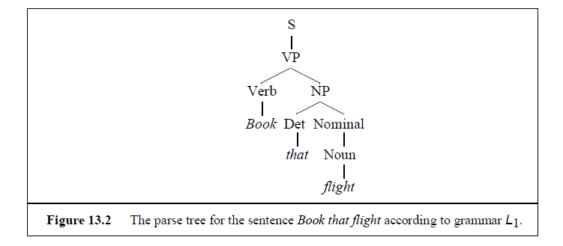
Parsing as Search

Slide 10
Parsing as Search
How can we use L1 Grammar to assign the parse tree to this example?
The goal of a parsing search is to find all the trees whose root is the start symbol S and which cover exactly the words in the input.
Search strategies:
Top down
Bottom up

Slide 11
Top down parsing
A top-down parser searches for a parse tree by trying to build from the root node S down to the leaves.
The algorithm starts by assuming the input can be derived by the designated start symbol S.
The next step is to find the tops of all trees which can start with S, by looking for all the grammar rules with S on the left-hand side.
In the grammar there are three rules that expand S
so the second ply, or level, of the search space has three partial trees.

Slide 12
Top down parsing
in the third ply a subset of the trees is shown that result from the expansion of the left-most leaves of each tree.
At each ply of the search space use the right-hand sides of the rules to recursively generate the rest of the trees.
Trees are grown downward until they eventually reach the part-of-speech categories at the bottom of the tree.
At this point, trees whose leaves fail to match all the words in the input can be rejected, leaving behind those trees that represent successful parses.
only the fifth parse tree in the third ply (the one which has expanded the rule VP → Verb NP) will eventually match the input sentence Book that flight.

Slide 13
Parsing as Search
Problem: Show top down and Bottom up parse for “Book that flight”

Slide 14
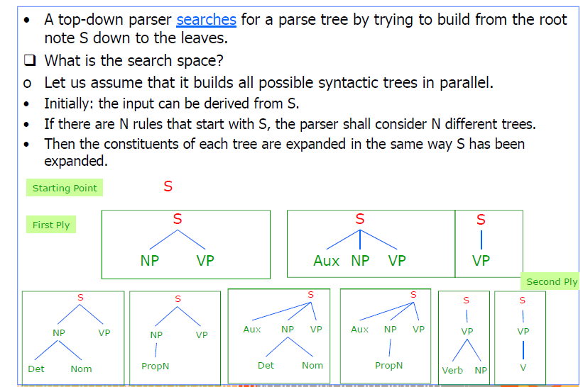
Top down parsing

Slide 15
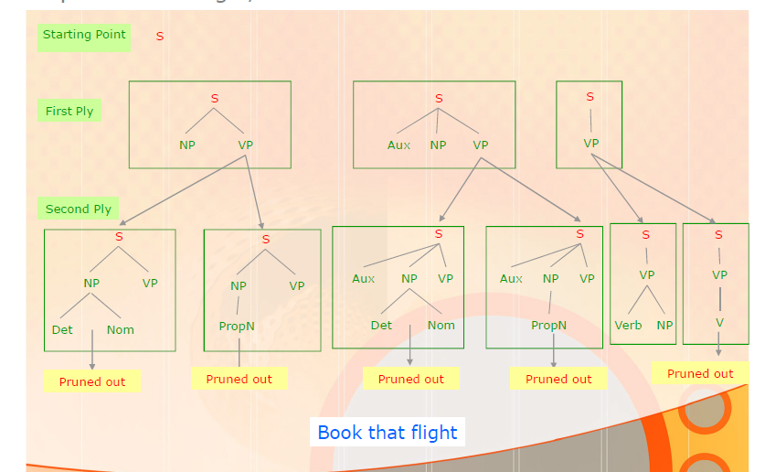
Top down parsing

Slide 16
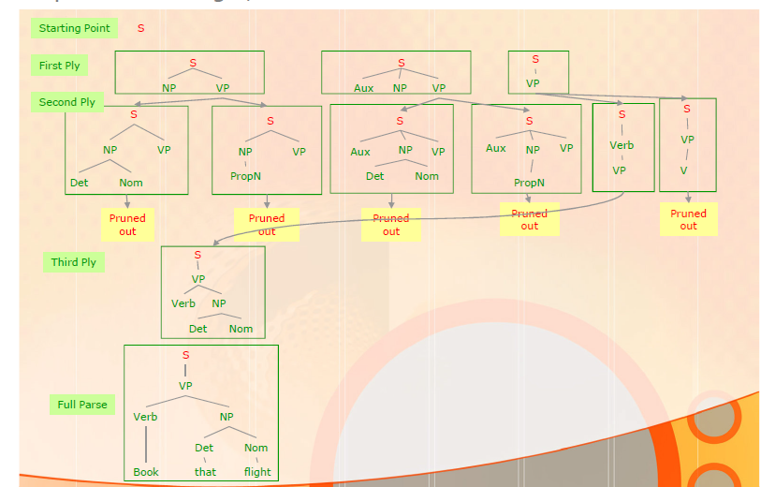
Top down parsing

Slide 17
Bottom up parsing
Top-down parsing
expands trees by applying rules when their left-hand side match an unexpanded non-terminal.
Bottom up parsing
Looking for right-hand side of some rule that might fit

Slide 18
Parsing as Search
Problem: Show top down and Bottom up parse for “Book that flight”

Slide 19
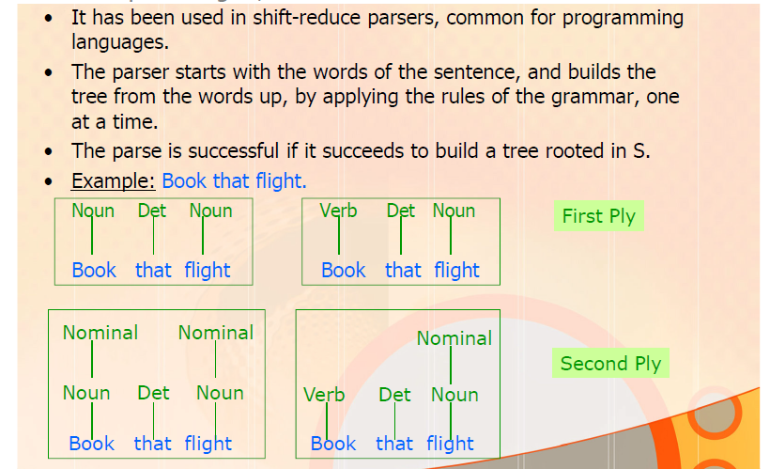
Bottom up parsing

Slide 20
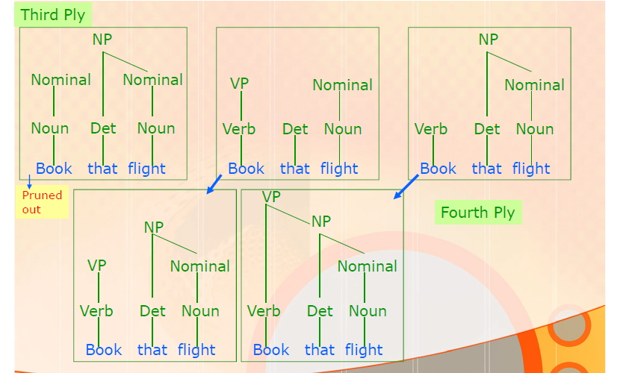
Bottom up parsing

Slide 21
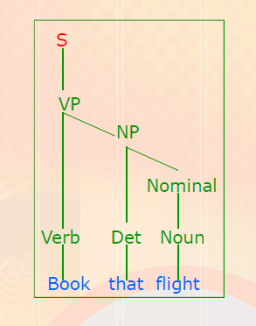
Bottom up parsing

Slide 22
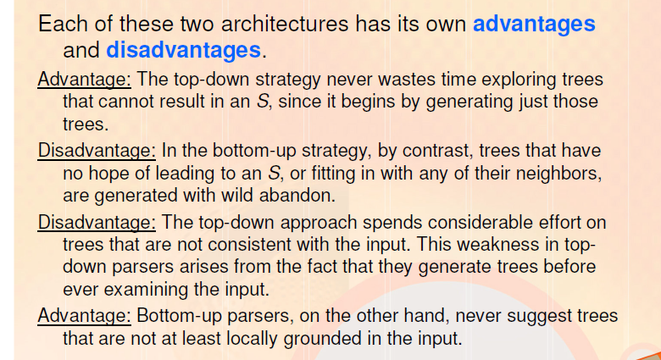
Comparing top down and Bottom up parsing

Slide 23
Ambiguity
Ambiguity is the most serious problem faced by parsers.
We have seen
part-of-speech ambiguity and
part-of-speech disambiguation.
a new kind of ambiguity, arises in the syntactic structures used in parsing, called structural ambiguity.
Structural ambiguity occurs when the grammar assigns more than one possible parse to a sentence.

Slide 24
Ambiguity
Structural ambiguity types:
attachment ambiguity and
coordination ambiguity.

Slide 25
Ambiguity
A sentence has an attachment ambiguity if a particular constituent can be attached to the parse tree at more than one place.
I shot an elephant in my pajamas
The sentence above is an example of PP-attachment ambiguity.
Various kinds of adverbial phrases are also subject to this kind of ambiguity.

Slide 26
Ambiguity
Draw parse tree for using the grammar shown next.
I shot an elephant in my pajamas.

Slide 27
CFG

Slide 28
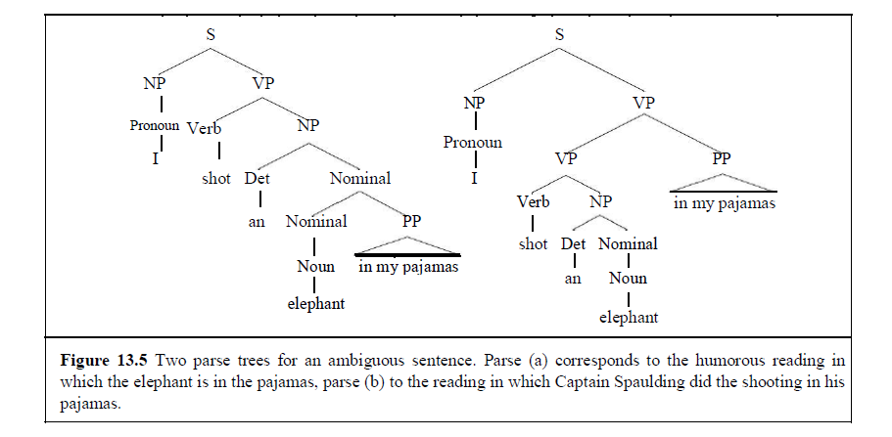
Ambiguity
Ambiguous because the phrase in my pajamas can be part of the NP headed by elephant or the verb-phrase headed by shot.

Slide 29
Ambiguity
In the following example the gerundive-VP flying to Paris can be part of a gerundive sentence whose subject is the Eiffel Tower or it can be an adjunct modifying the VP headed by saw:
Ex2: We saw the Eiffel Tower flying to Paris
Draw parse tree

Slide 30
Ambiguity
In coordination ambiguity there are different sets of phrases that can be conjoined by a conjunction like and.
Ex:
the phrase old men and women can be bracketed as [old [men and women]], referring to old men and old women, or
as [old men] and [women], in which case it is only the men who are old.
Draw parse tree for “cows eat leaves and barks” to highlight coordination ambiguity

Slide 31
Ambiguity
The fact that there are many unreasonable parses for naturally occurring sentences is problem that affects all parsers.
Ultimately, most natural language processing systems need to be able to choose the correct parse from the multitude of possible parses via process known as syntactic disambiguation.
Disambiguation algorithms generally require statistical, semantic, and pragmatic knowledge not readily available during syntactic processing

Slide 32
Ambiguity
Lacking such knowledge we are left with the choice of simply returning all the possible parse trees for a given input.
Leads to potentially exponential number of parses that are possible for certain inputs.
Ex:
Show me the meal on Flight UA 386 from San Francisco to Denver.
from San Francisco could be part of the VP headed by show
(which would have the bizarre interpretation that the showing was happening from San Francisco).
the number of parses for sentences of this type grows exponentially at the same rate as the number of parenthesizations of arithmetic expressions.

Slide 33
Parsing as Search
Note: This grammar has not been used for “Show me the meal on Flight UA 386 from San Francisco to Denver” since VP -> VERB NP NP is missing here

Slide 34
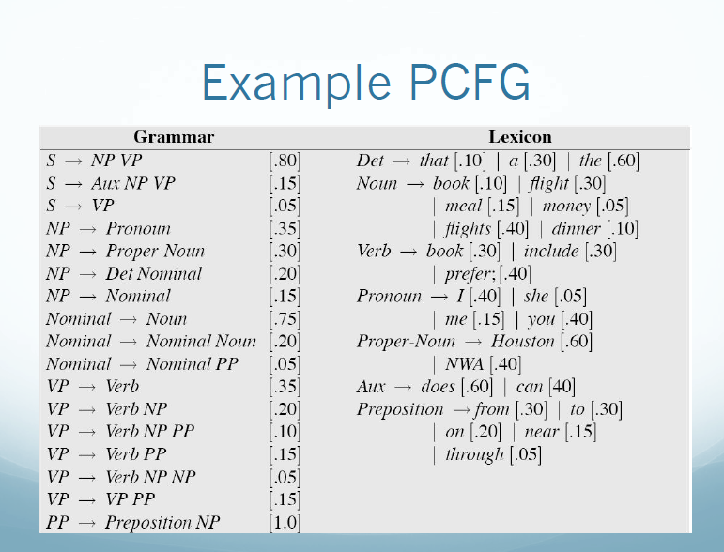
Note: This grammar has been used for “Show me the meal on Flight UA 386 from San Francisco to Denver”

Slide 35
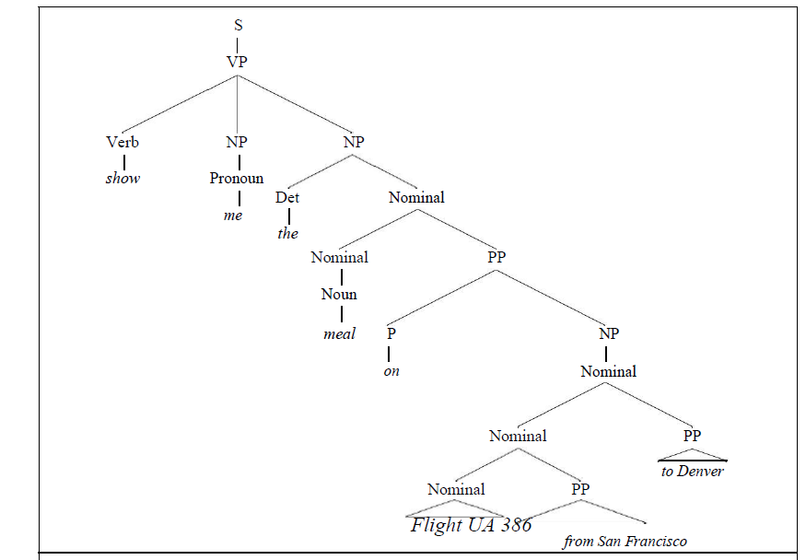
Ambiguity
A reasonable parse

Slide 36
Ambiguity
Even if a sentence is not ambiguous (i.e. it doesn‘t have more than one parse in the end), it can be inefficient to parse due to local ambiguity.
Local ambiguity occurs when some part of a sentence is ambiguous, that is, has more than one parse, even if the whole sentence is not ambiguous.
Ex: the sentence Book that flight is unambiguous
but when the parser sees the first word Book, it cannot know if it is a verb or a noun until later.
Thus it must consider both possible parses.

Slide 37
Ambiguity
Adjunct - Grammar
a word or word group that qualifies or completes the meaning of another word or other words and is not itself a main structural element in its sentence
an adverb or adverbial phrase (such as heartily in "They ate heartily" or at noon in "We left at noon") attached to the verb of a clause especially to express a relation of time, place, frequency, degree, or manner

Slide 38
Statistical parsing

Slide 39
Statistical parsing - Outline
probabilistic parsers
it is possible to build probabilistic models of syntactic knowledge and
Use this probabilistic knowledge in efficient probabilistic parsers.

Slide 40
Statistical parsing
Applications of probabilistic parsing
One crucial use of probabilistic parsing is to solve the problem of disambiguation
The CKY parsing algorithms could represent these ambiguities in an efficient way,
but are not equipped to resolve them.
A probabilistic parser offers a solution to the problem:
compute the probability of each interpretation, and
choose the most-probable interpretation.
Note: due to the ambiguity, modern parsers used for natural language understanding tasks (thematic role labeling, summarization, question-answering, machine translation) are of necessity probabilistic.

Slide 41
Statistical parsing
Applications of probabilistic parsing
Another important use of probabilistic grammars and parsers is in language modeling for speech recognition.
We saw that N-gram are used in speech recognizers to predict upcoming words,
Probabilistic versions of more sophisticated grammars can provide additional predictive power to a speech recognizer

Slide 42
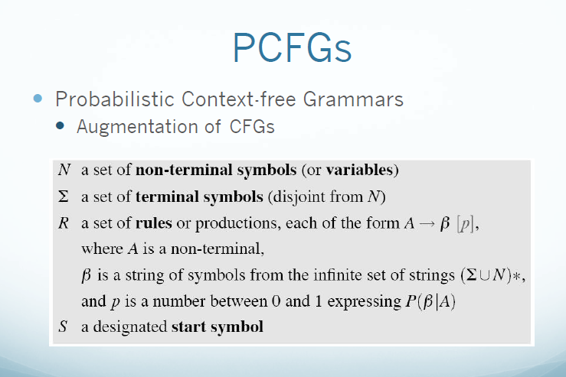
Note: also known as the Stochastic Context-Free Grammar (SCFG)

Slide 43
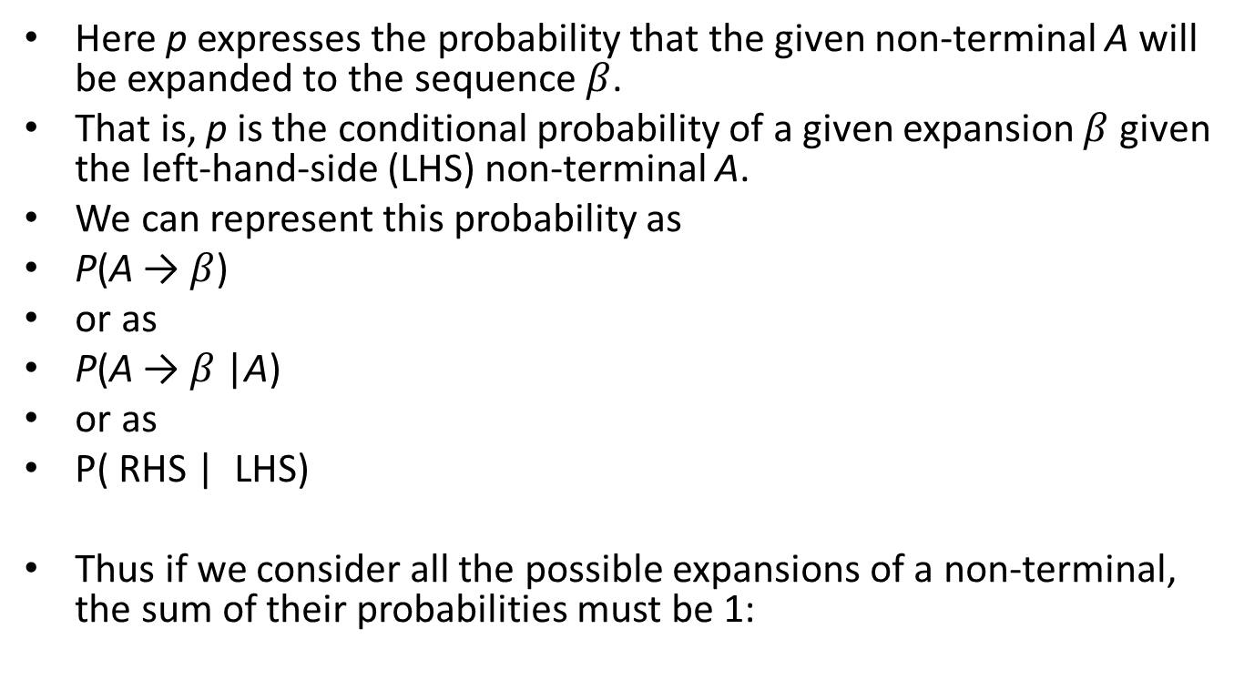
PCFG
Here p expresses the probability that the given non-terminal A will be expanded to the sequence $β$.
That is, p is the conditional probability of a given expansion $β$ given the left-hand-side (LHS) non-terminal A.
We can represent this probability as
P(A → $β$)
or as
P(A → $β$|A)
or as
P( RHS | LHS)
Thus if we consider all the possible expansions of a non-terminal, the sum of their probabilities must be 1:

Slide 44
Note: In any real grammar there are many more rules for each non-terminal
hence the probabilities of any particular rule would tend to be much smaller.

Slide 45
PCFG - Consistent
A PCFG is said to be consistent if the sum of the probabilities of all sentences in the language equals 1.
Certain kinds of recursive rules cause a grammar to be inconsistent by causing infinitely looping derivations for some sentences.
Ex: a rule S → S with probability 1 would lead to lost probability mass due to derivations that never terminate.

Slide 46
PCFG
How are PCFGs used?
A PCFG can be used to estimate a number of useful prob-abilities
concerning a sentence and its parse tree(s)
the probability of a particular parse tree (useful in disambiguation)
and the probability of a sentence
or a piece of a sentence (useful in language modeling)

Slide 47
PCFG- Problem Stmt
Compute the most probable parse tree for the following sentence:
Book the dinner flight
Procedure:
1) Draw parse trees to check if the grammar has ambiguities
2) Compute probability of each tree
3) Get the highest PCFG probable derivation

Slide 48
Note: In any real grammar there are many more rules for each non-terminal
hence the probabilities of any particular rule would tend to be much smaller.

Slide 49
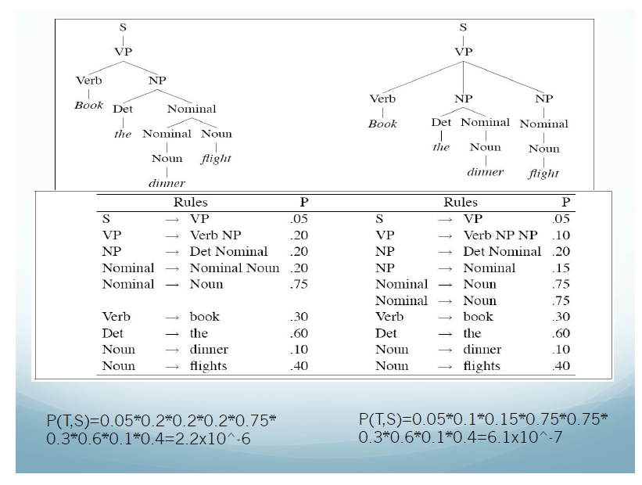
Note: Consider all internal nodes from left to right first and then at the end, consider all leaves from right to left.

Slide 50
Probabilistic CFGs
The probability of each of the trees can be computed
by multiplying together the probabilities of each of the rules used in the derivation.
Ex: probability of the left tree Tleft and the right tree Tright can be computed as follows:
P(Tleft) = .05 ∗ .20 ∗ .20 ∗ .20 ∗ .75 ∗ .30 ∗ .60 ∗ .10 ∗ .40 = 2.2 × 10−6
P(Tright) = .05 ∗ .10 ∗ .20 ∗ .15 ∗ .75 ∗ .75 ∗ .30 ∗ .60 ∗ .10 ∗ .40 = 6.1 × 10−7
We can see that the left (transitive) tree has a much higher probability than the ditransitive tree on the right.
Thus this parse would correctly be chosen by a disambiguation algorithm which selects the parse with the highest PCFG probability

Slide 51
Statistical parsing
A PCFG assigns a probability to each parse tree T (i.e., each derivation) of a sentence S.
This attribute is useful in disambiguation.
Ex: consider the two parses ―Book the dinner flights
parse on the left means ―Book flights that serve dinner
The parse on the right mean Book flights on behalf of `the dinner'?

Slide 52
Dynamic Programming parsing Methods

Slide 53
Dynamic Programming parsing Methods
standard bottom-up or top-down parsers
Suffer from ambiguity problems
Dynamic programming
can solve these problems.
tables are used to store subtrees for each of the various constituents in the input as they are discovered.
efficient
these subtrees are discovered once, stored, and then used in all parses calling for that constituent.
solves the re-parsing problem
subtrees are looked up, not re-parsed
partially solves the ambiguity problem
the dynamic programming table implicitly stores all possible parses by storing all the constituents with links that enable the parses to be reconstructed

Slide 54
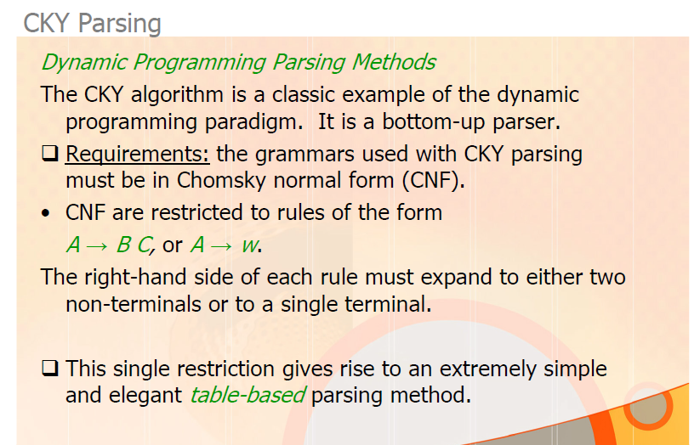
Note: Assuming an ε-free grammar

Slide 55
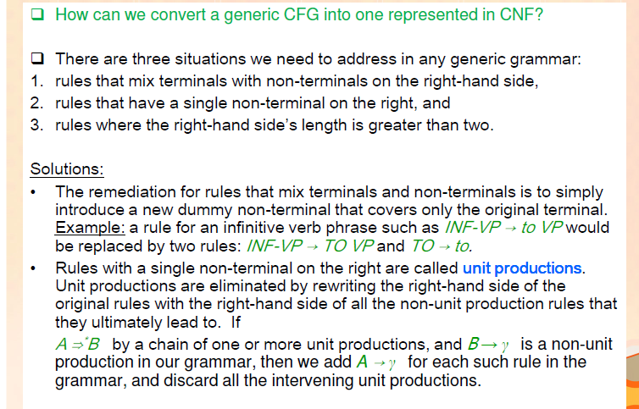
CKY Parsing – Conversion to CNF

Slide 56
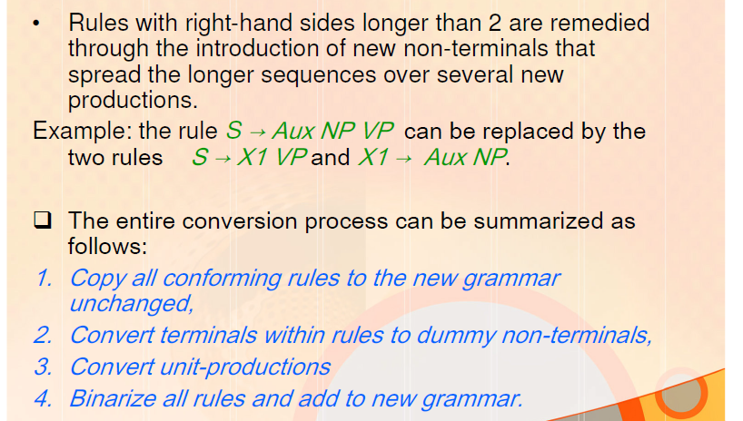
CKY Parsing – Conversion to CNF

Slide 57
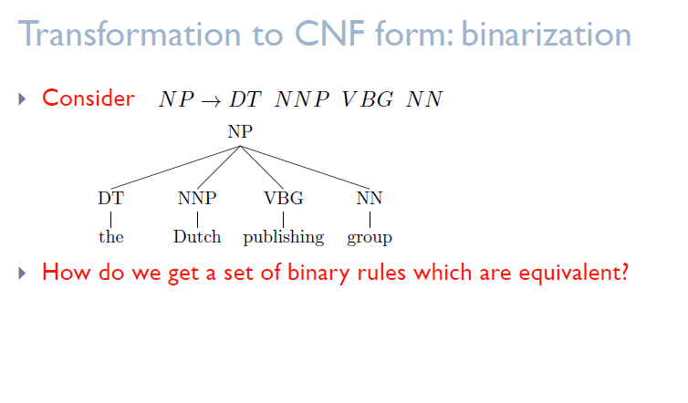
CKY Parsing – Conversion to CNF

Slide 58
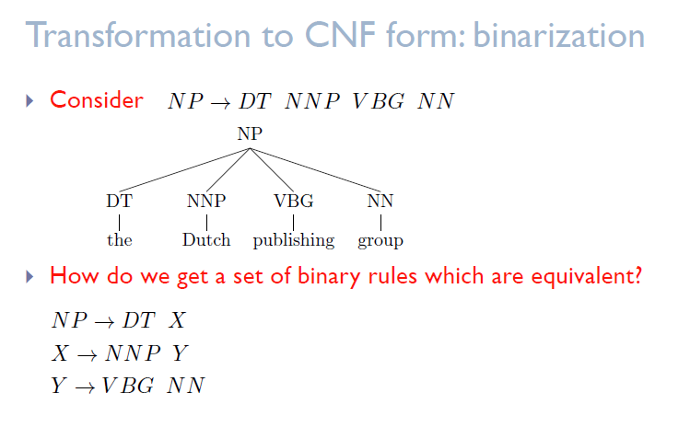
CKY Parsing – Conversion to CNF

Slide 59
CKY Parsing
CFG to CNF Conversion: Equivalence
any context-free grammar can be converted into a CNF grammar
that accepts exactly the same set of strings as the original grammar.

Slide 60
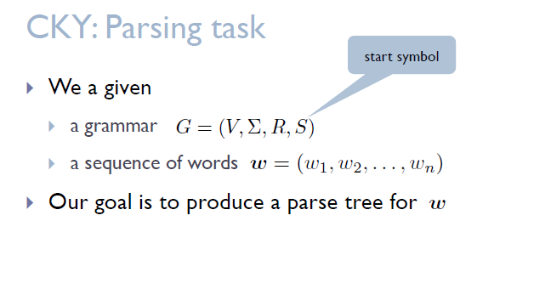
CKY Parsing

Slide 61
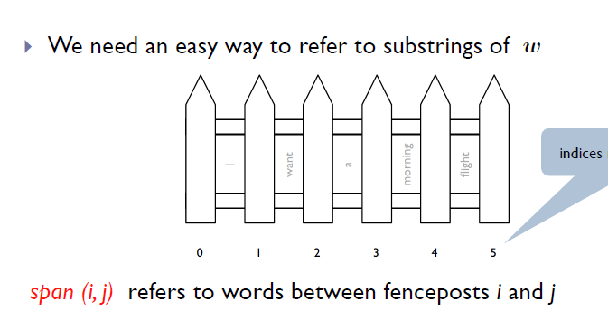
CKY Parsing

Slide 62
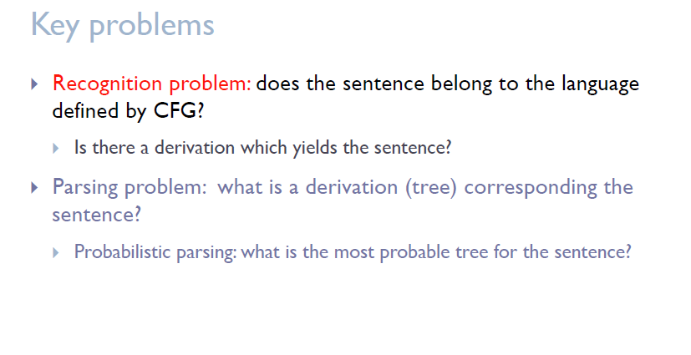
CKY Parsing

Slide 63
CKY Parsing
Show the results of applying the conversion procedure to the L1 grammar
Note that the original lexical rules carry over unchanged to the new grammar.

Slide 64
Parsing as Search

Slide 65
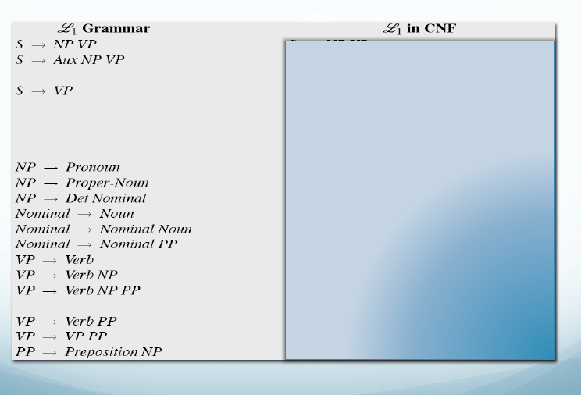
CKY Recognition

Slide 66
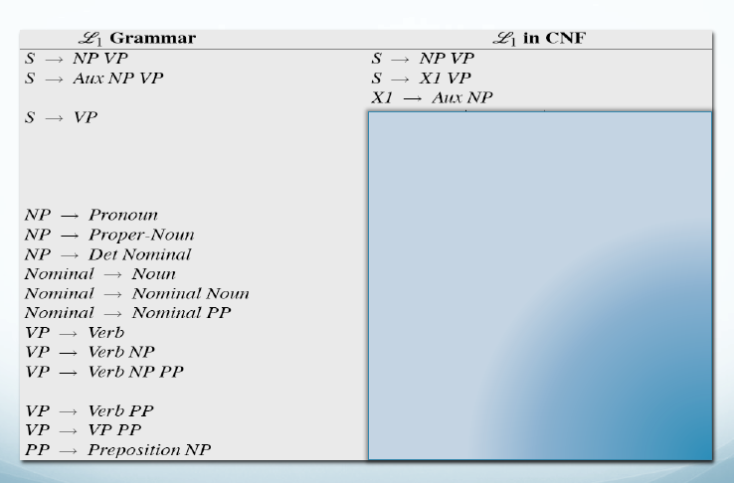
CKY Recognition

Slide 67
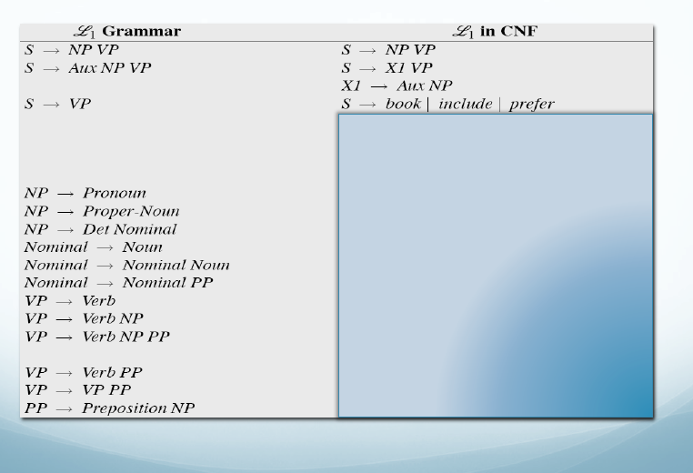
CKY Recognition

Slide 68
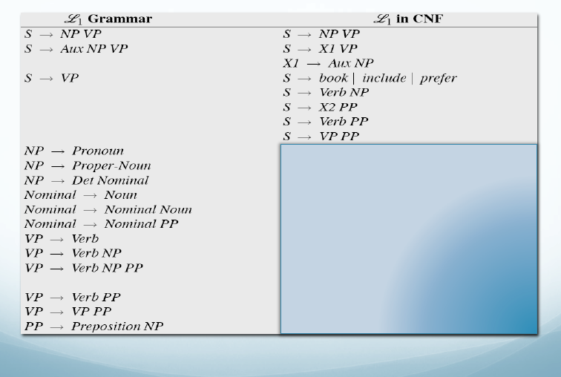
CKY Recognition

Slide 69
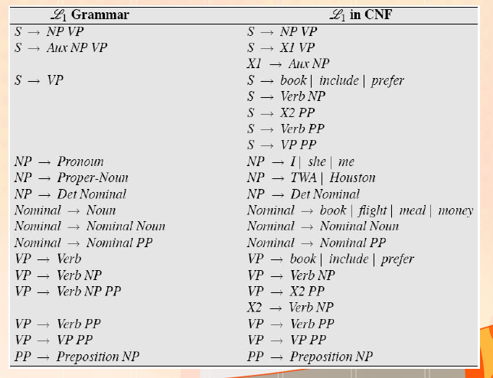
CKY Recognition

Slide 70
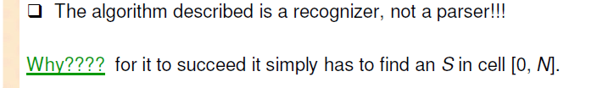
CKY Recognition
If [0, n] contains Start symbol, the sentence is recognized

Slide 71
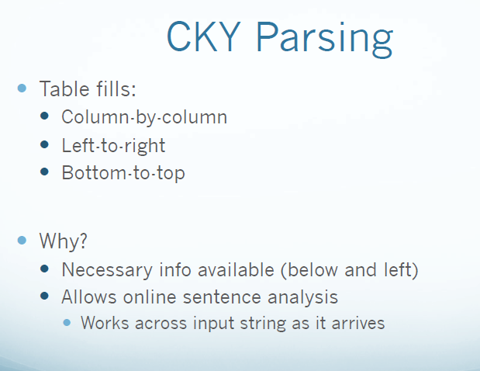

Slide 72
CKY Recognition
Construct Parse table for “Book the flight through Houston”

Slide 73
CKY Recognition

Slide 74
Parsing as Search

Slide 75
CKY Parsing

Slide 76
